Slide 1
Meet enigma

Slide 2
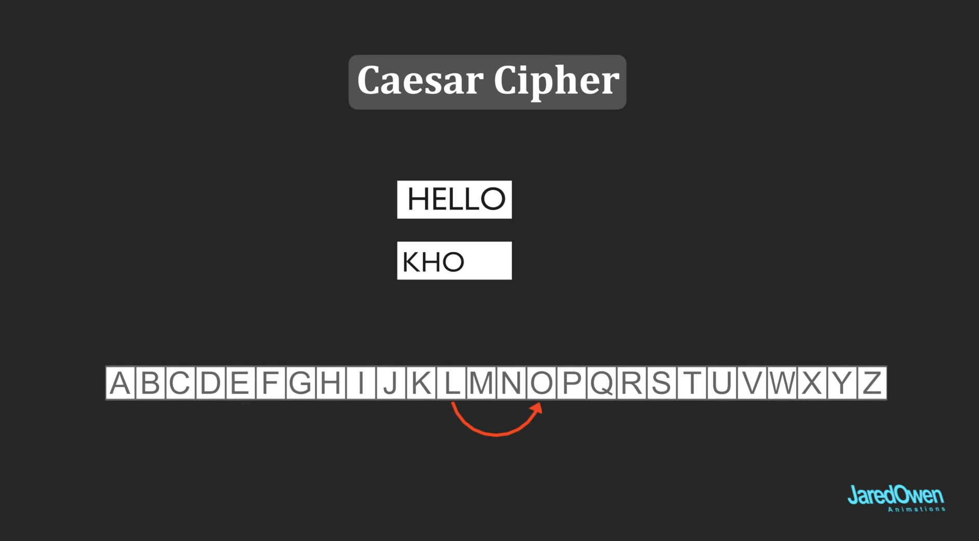
Caesar Cipher

Slide 3
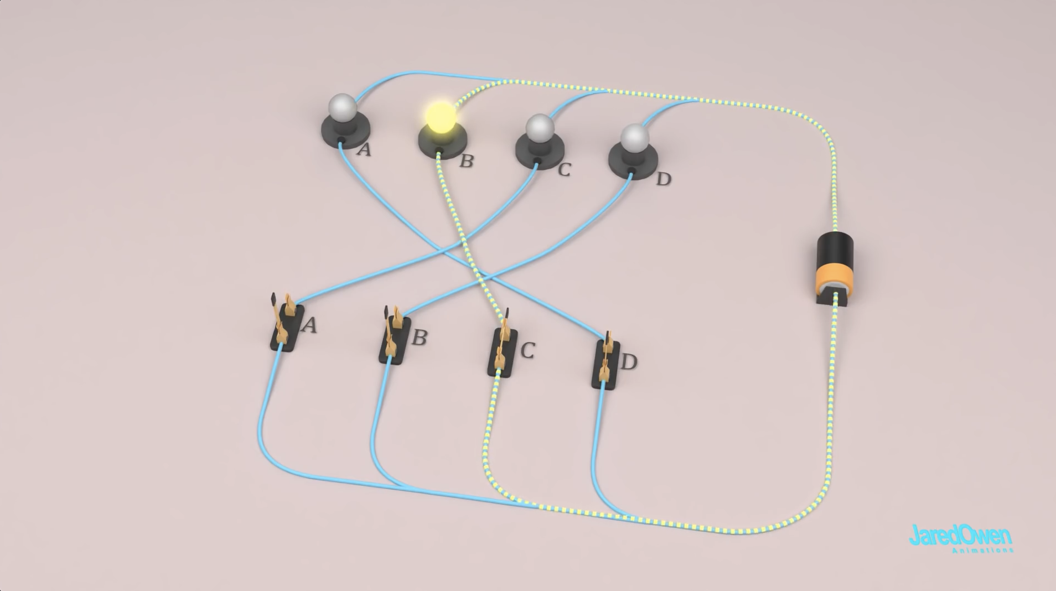
Simple Circulation

Slide 4
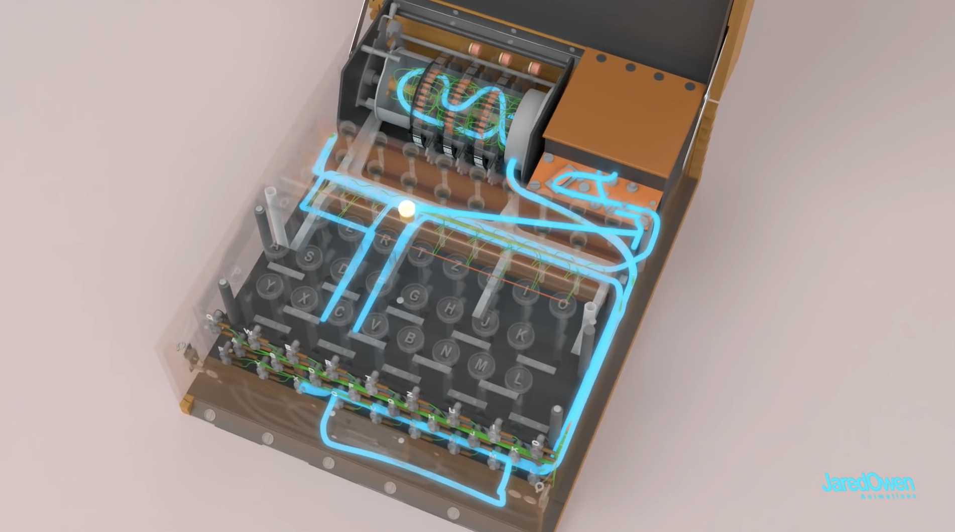
Full Circulation

Slide 5
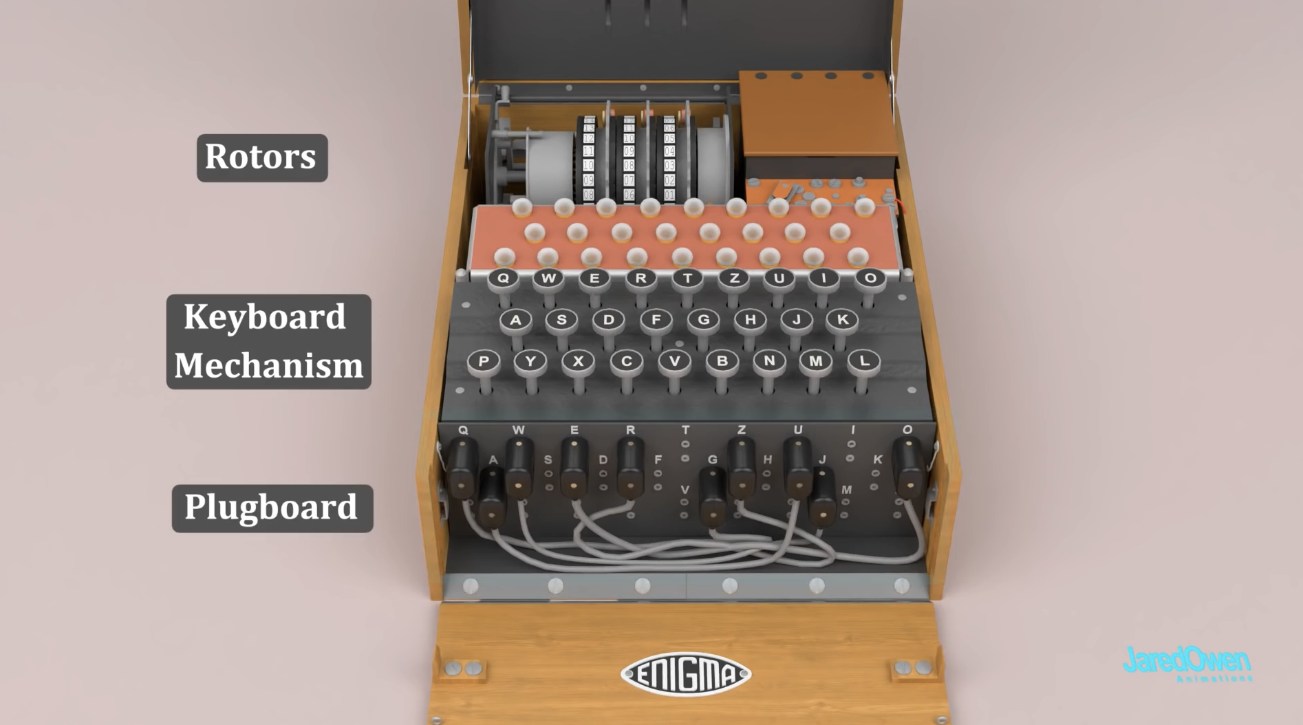
Structure

Slide 6
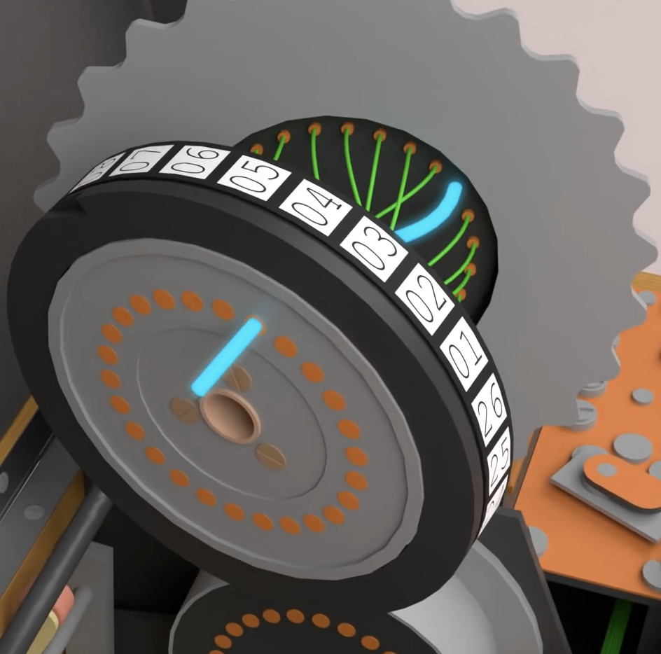
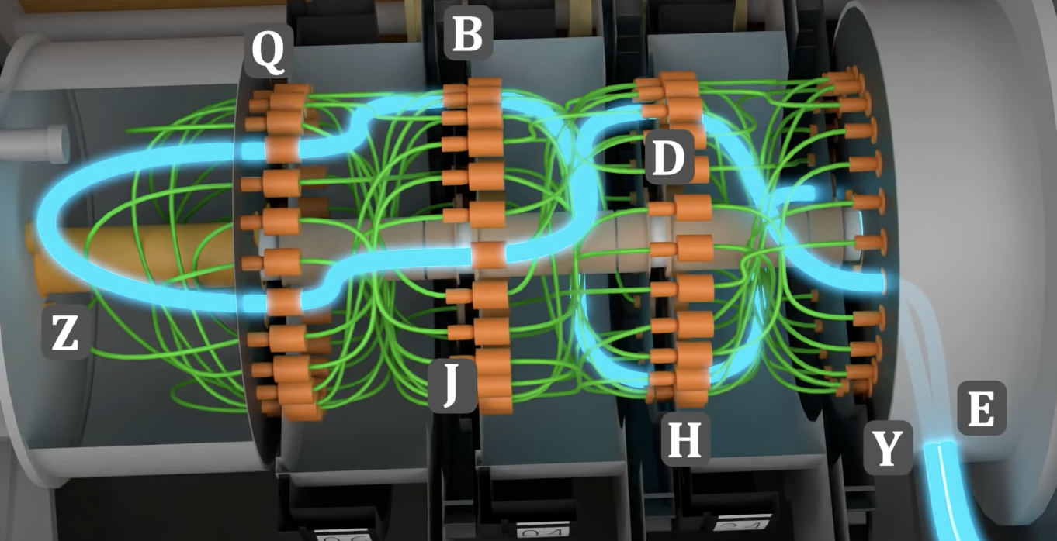
Rotors

Slide 7
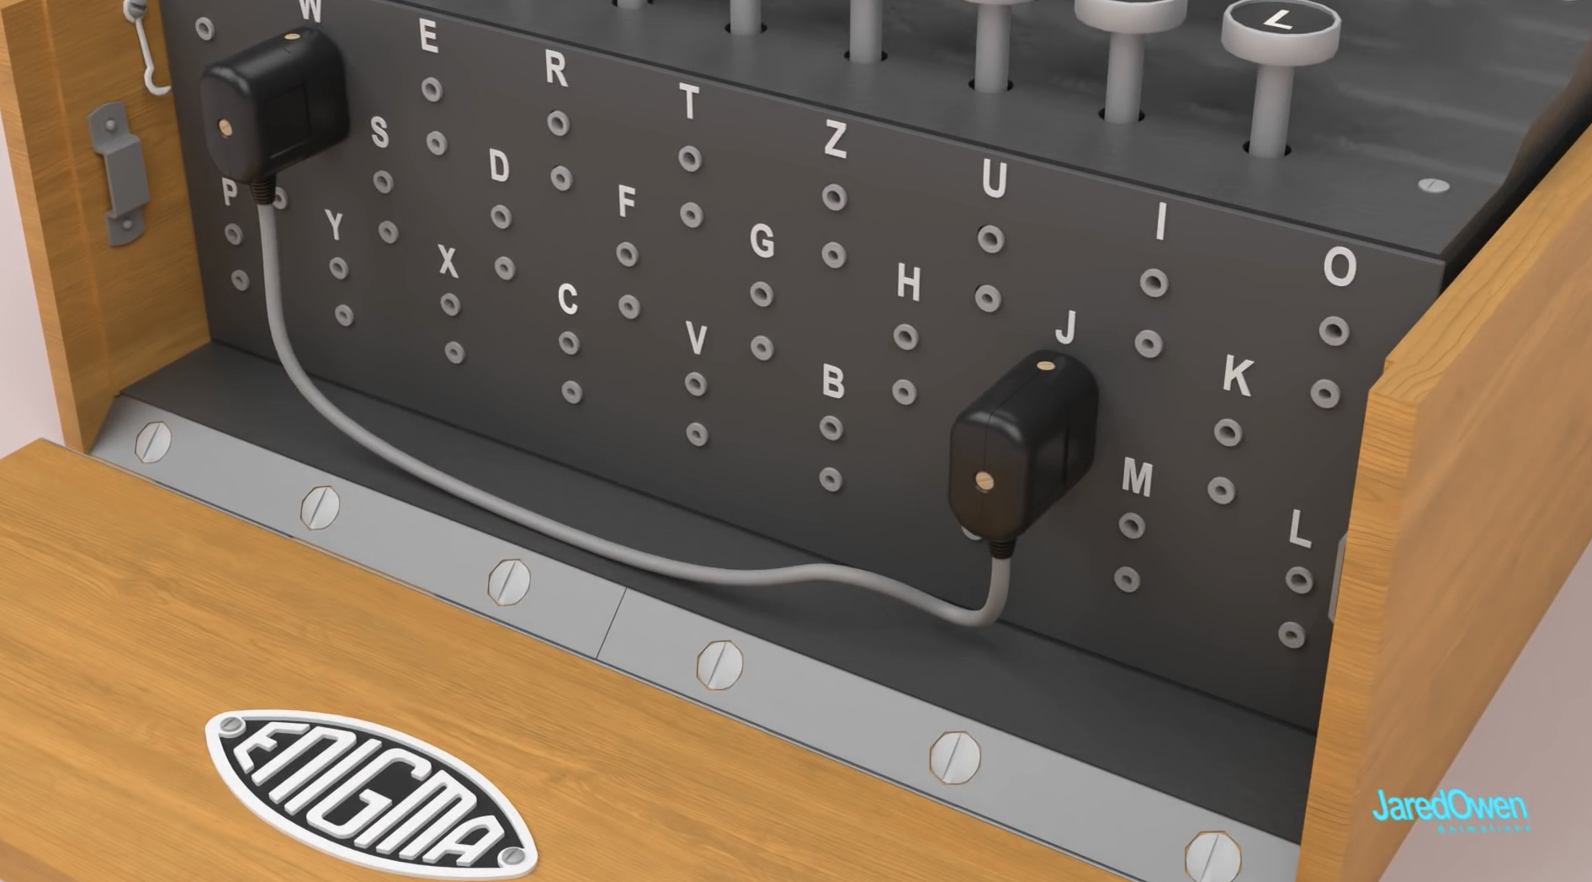
Plugboard

Slide 8
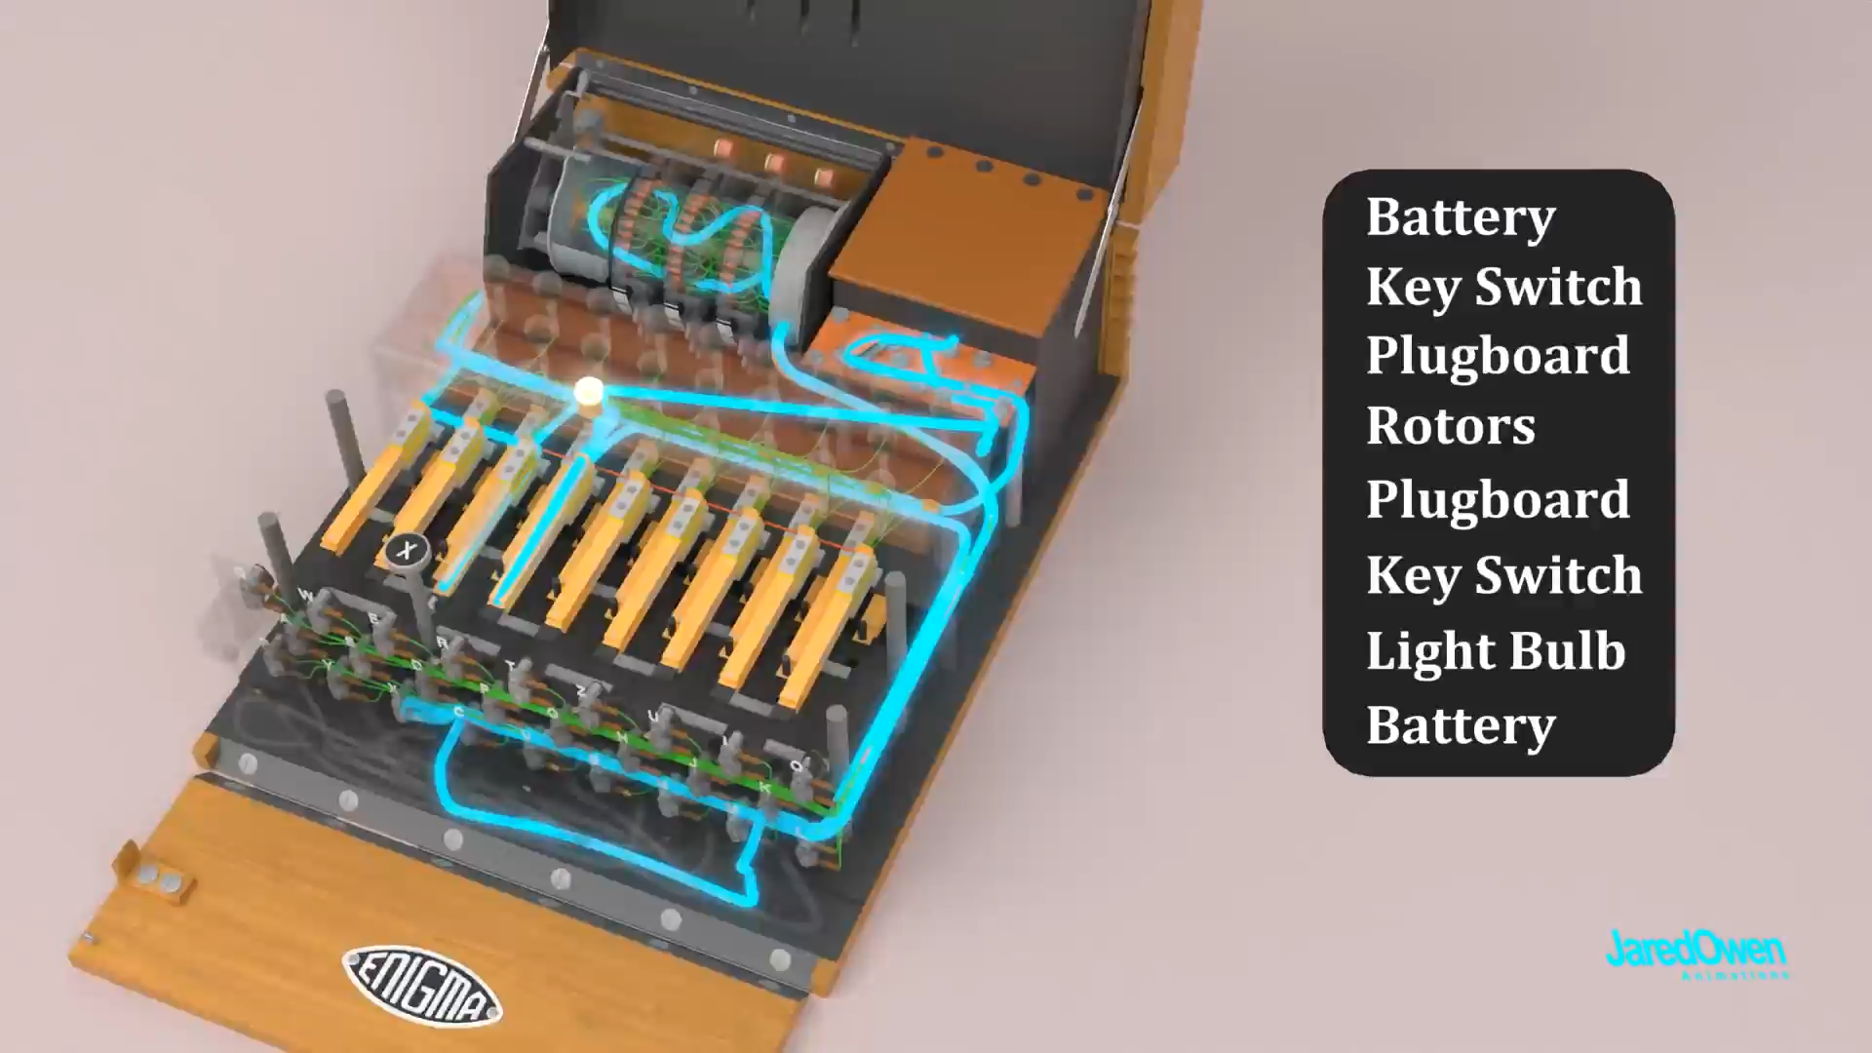
Animation

Slide 9
Author & Source link
https://www.youtube.com/watch?v=ybkkiGtJmkM

